Slide 1
Unit-III
More on Public-Key Cryptosystems
1

Slide 2
Principles of Public –Key Cryptosystems
Public-key encryption scheme has six ingredients
Plaintext: readable message or data
Encryption algorithm: performs various transformations on the plaintext.
Public and private keys: pair of keys, one is used for encryption, the other is used for decryption.
Ciphertext: scrambled message
Decryption algorithm: accepts the ciphertext and the matching key and produces the original plaintext.
2

Slide 3
Characteristics of Public –Key Cryptosystems
It is computationally infeasible to determine the decryption key given only knowledge of the cryptographic algorithm and the encryption key.
Either of the two related keys can be used for encryption, with the other used for decryption.
3

Slide 4
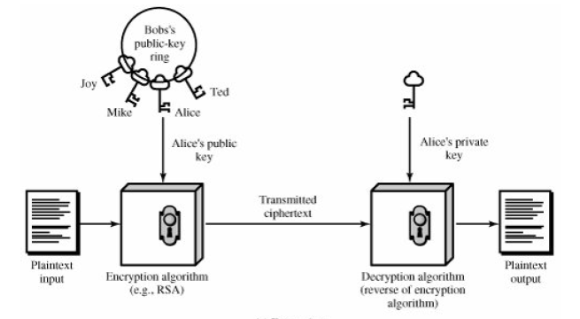
Public Key Encryption
4

Slide 5
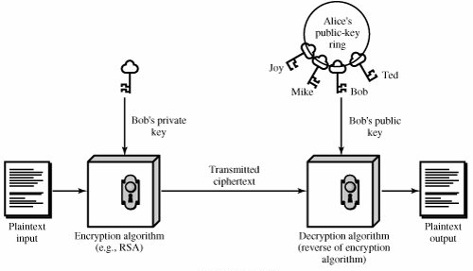
Authentication
5

Slide 6
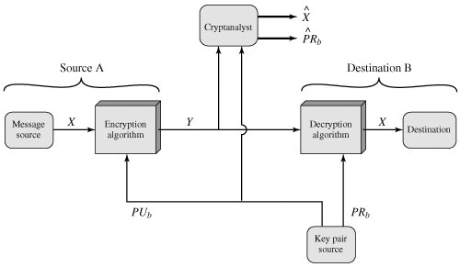
Public-Key Cryptosystem: Secrecy
6

Slide 7
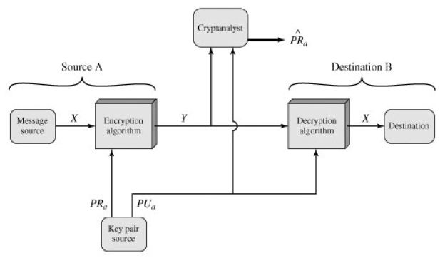
Public-Key Cryptosystem: Authentication
7

Slide 8
Classification of uses of public-key cryptosystems
Encryption/Decryption
Digital Signature
Key exchange
8

Slide 9
Requirements for Public-Key Cryptography
It is computationally easy for a party B to generate a pair (public key Pub, private key PRb).
It is computationally easy for a sender A, knowing the public key and the message to be encrypted,M, to generate the corresponding ciphertext:
C = E(PUb,M) or
It is computationally easy for the receiver B to decrypt the resulting ciphertext using the private key to recover the original message:
M = D(PRb, C) = D[PRb, E(PUb,M)]
9

Slide 10
Requirements for Public-Key Cryptography
It is computationally infeasible for an adversary, knowing the public key, PUb, to determine the private key,PRb.
It is computationally infeasible for an adversary, knowing the public key, PUb, and a ciphertext, C, to recover the original message,M.
The two keys can be applied in either order: M = D[PUb, E(PRb,M)] = D[PRb, E(PUb,M)]
10

Slide 11
A one-way function3 is one that maps a domain into a range such that every function value has a unique inverse, with the condition that the calculation of the
function is easy, whereas the calculation of the inverse is infeasible:
X = f-1(Y) infeasible
Y = f(X) easy
Generally, easy is defined to mean a problem that can be solved in polynomial time as a function of input length. Thus, if the length of the input is n bits, then the time to compute the function is proportional to na, where a is a fixed constant
11

Slide 12
RSA – Rivest-Shamir-Adleman
Block cipher
Plaintext and ciphertext are integers between 0 and n - 1 for some n.
A typical size for n is 1024 bits, that is, n is less than 2¹⁰²⁴
Block size is I bits, where 2^{i} < n ≤ 2^{i+1}
Plaintext block M and ciphertext block C
C = Me mod n
M = C^{d} mod n
12

Slide 13
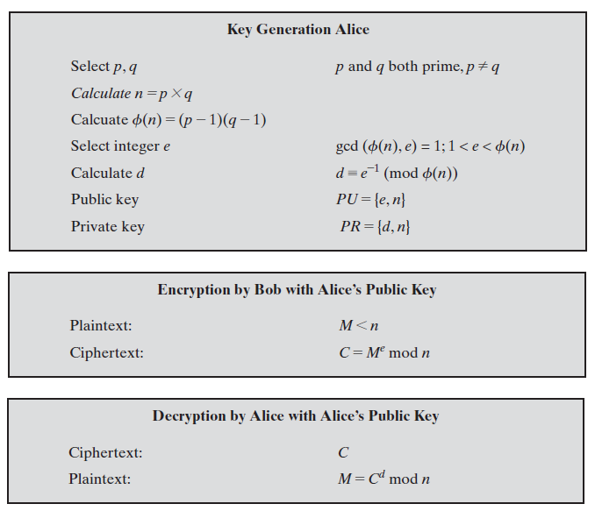
RSA Algorithm
13

Slide 14
RSA Example
For this example, the keys were generated as follows
Select two prime numbers, p = 17 and q = 11
Calculate n = pq = 17 × 11 = 187
Calculate Φ (n) = (p - 1)(q - 1) = 16 × 10 = 160
Select e such that e is relatively prime to Φ (n) = 160 and less than f(n); we choose e = 7
Determine d such that de = 1(mod 160) and d < 160 The correct value is d = 23, because 23 × 7 = 161 = (1 × 160) + 1; d can be calculated using the extended Euclid’s algorithm
The resulting keys are public key PU = {7, 187} and private key PR = {23, 187}
For encryption, we need to calculate C = 887 mod 187
For decryption, we calculate M = 1123 mod 187
14

Slide 15
Key Management
The distribution of public keys
The use of public-key encryption to distribute secret keys
15

Slide 16
Distribution of public keys
Public announcement
Publicly available directory
Public-key authority
Public-key certificates
16

Slide 17
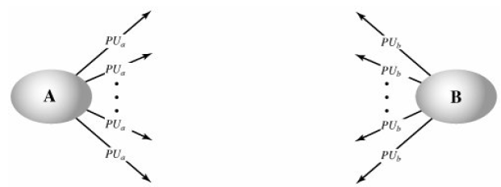
1. Public announcement
Participant can send his or her public key to any other participant or broadcast the key to the community at large
Convenient but Anyone can forge such a public announcement and pretend to be user A and send a public key to another participant or broadcast such a public key
17

Slide 18
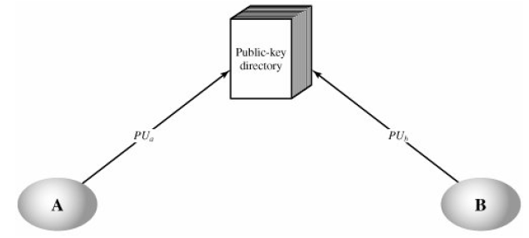
2. Publicly available directory
The authority maintains a directory with a {name, public key} entry for each participant.
Each participant registers a public key with the directory authority.
Registration is in person/secure authenticated communication.
A participant may replace the existing key with a new one at any time
Participants could also
access the directory
electronically.
18

Slide 19
3. Public-key authority
A sends a timestamped message to the public-key authority containing a request for the current public key of B.
The authority responds with a message that is encrypted using the authority's private key, PR_{auth}
B's public key, PUb which A can use to encrypt messages destined for B
The original request, to enable A to match this response
The original timestamp, so A can determine that this is not an old message
19

Slide 20
A stores B's public key and also uses it to encrypt a message to B containing an identifier of A (ID_{A}) and a nonce (N1), which is used to identify this transaction uniquely.
B retrieves A's public key from the authority in the same manner as A retrieved B's public key.
B sends a message to A encrypted with PUa and containing A's nonce (N1) as well as a new nonce generated by B (N2)
presence of N1 in message assures A that the correspondent is B.
A returns N2, encrypted using B's public key, to assure B that its correspondent is A.

Slide 21
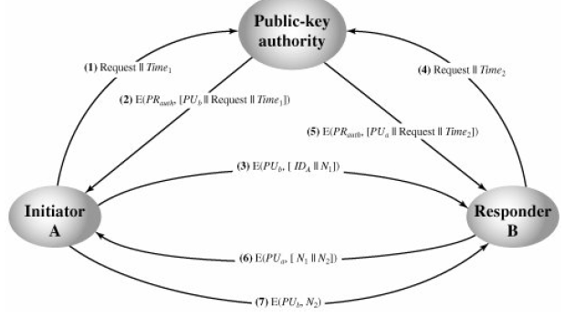
3. Public-key authority
21

Slide 22
4. Public-key certificates
Use certificates that can be used by participants to exchange keys without contacting a public-key authority
Certificate consists of a public key plus an identifier of the key owner, with the whole block signed by a trusted third party.
The third party is a certificate authority, such as a government agency or a financial institution, that is trusted by the user community
A user can present his or her public key to the authority in a secure manner, and obtain a certificate
The user can then publish the certificate
Anyone needed this user's public key can obtain the certificate and verify that it is valid by way of the attached trusted signature
A participant can also convey its key information to another by transmitting its certificate
Other participants can verify that the certificate was created by the authority
22

Slide 23
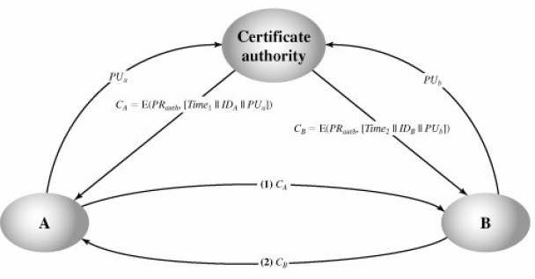
Public-key certificates
23

Slide 24
Symmetric Key Distribution Using Public Keys
public key cryptosystems are inefficient
so almost never use for direct data encryption
rather use to encrypt secret keys for distribution
24
Notes:
Because of the inefficiency of public key cryptosystems, they are almost never used for the direct encryption of sizable block of data, but are limited to relatively small blocks. One of the most important uses of a public key cryptosystem is to encrypt secret keys for distribution. We see many specific examples of this later in the text.
24

Slide 25
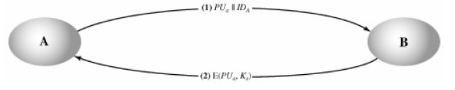
Simple Secret Key Distribution
A generates a public/private key pair {PUa, PRa} and transmits a message to B consisting of Pua and an identifier of A, IDA.
B generates a secret key, Ks, and transmits it to A, encrypted with A's public key.
A computes D(PRa, E(PUa, Ks)) to recover the secret key. Because only A can decrypt the message, only A and B will know the identity of Ks.
A discards PUa and PRa and B discards PUa.
25

Slide 26
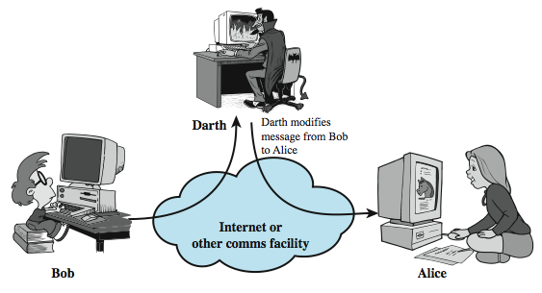
Man-in-the-Middle Attack
this very simple scheme is vulnerable to an active man-in-the-middle attack
26
Notes:
The protocol depicted in Figure 14.7 is insecure against an adversary who can intercept messages and then either relay the intercepted message or substitute another message (see Stallings Figure 1.3c). Such an attack is known as a man-in-the-middle attack. In this case, if an adversary, E, has control of the intervening communication channel, then E can compromise the communication in the following fashion without being detected:
A generates a public/private key pair {PUa, PRa} and transmits a message intended for B consisting of PUa and an identifier of A, IDA.
E intercepts the message, creates its own public/private key pair {PUe, PRe} and transmits PUe || IDA to B.
B generates a secret key, Ks, and transmits E(PUe, Ks).
E intercepts the message and learns Ks by computing D(PRe, E(PUe, Ks)).
E transmits E(PUa, Ks) to A.
The result is that both A and B know Ks and are unaware that Ks has also been revealed to E. A and B can now exchange messages using Ks. E no longer actively interferes with the communications channel but simply eavesdrops. Knowing Ks, E can decrypt all messages, and both A and B are unaware of the problem. Thus, this simple protocol is only useful in an environment where the only threat is eavesdropping.
26

Slide 27
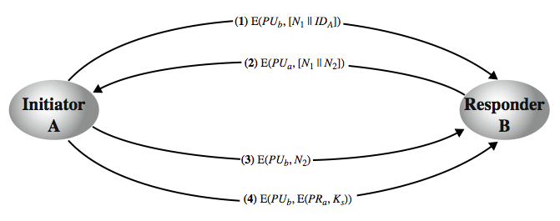
Secret Key Distribution with Confidentiality and Authentication
27
Notes:
Stallings Figure 14.8, based on an approach suggested in [NEED78], provides protection against both active and passive attacks. Assuming A and B have exchanged public keys by one of the schemes described subsequently in this chapter, then the following steps occur:
A uses B's public key to encrypt a message to B containing an identifier of A (IA) and a nonce (N1), which is used to identify this transaction uniquely.
B sends a message to A encrypted with PUa and containing A's nonce (N1) as well as a new nonce generated by B (N2). Because only B could have decrypted message (1), the presence of N1 in message (2) assures A that the correspondent is B.
A returns N2, encrypted using B's public key, to assure B that its correspondent is A.
A selects a secret key Ks and sends M = E(PUb, E(PRa, Ks)) to B. Encryption with B's public key ensures that only B can read it; encryption with A's private key ensures that only A could have sent it.
B computes D(PUa, D(PRb, M)) to recover the secret key.
The result is that this scheme ensures both confidentiality and authentication in the exchange of a secret key.
27

Slide 28
Secret Key Distribution with Confidentiality and Authentication
1. A uses B's public key to encrypt a message to B containing an identifier of A (IDA) and a nonce (N1), which is used to identify this transaction uniquely.
2. B sends a message to A encrypted with PUa and containing A's nonce (N1) as well as a new nonce generated by B (N2) Because only B could have decrypted message (1), the presence of N1 in message (2) assures A that the correspondent is B.
3. A returns N2 encrypted using B's public key, to assure B that its correspondent is A.
4. A selects a secret key Ks and sends M = E(PUb, E(PRa, Ks)) to B. Encryption of this message with B's public key ensures that only B can read it; encryption with A's private key ensures that only A could have sent it.
5. B computes D(PUa, D(PRb, M)) to recover the secret key.
28

Slide 29
Hybrid Key Distribution
This scheme retains the use of a key distribution center (KDC) that shares a secret master key with each user and distributes secret session keys encrypted with the master key.
A public key scheme is used to distribute the master keys
Performance
Distribution of session keys by public-key encryption could degrade overall system performance because of the relatively high computational load of public-key encryption and decryption. With a three-level hierarchy, public-key encryption is used only occasionally to update the master key between a user and the KDC.
backward compatibility
The hybrid scheme is easily overlaid on an existing KDC scheme, with minimal disruption or software changes
29
Notes:
29
Yet another way to use public-key encryption to distribute secret keys is a hybrid approach in use on IBM mainframes [LE93]. This scheme retains the use of a key distribution center (KDC) that shares a secret master key with each user and distributes secret session keys encrypted with the master key. A public key scheme is used to distribute the master keys. The addition of a public-key layer provides a secure, efficient means of distributing master keys. This is an advantage in a configuration in which a single KDC serves a widely distributed set of users.

Slide 30
The Diffie-Hellman algorithm depends for its effectiveness on the difficulty of computing discrete logarithms.
we can define the discrete logarithm in the following way. First, we define a primitive root of a prime number p as one whose powers modulo p generate all the integers from 1 to p -1.
That is, if a is a primitive root of the prime number p, then the numbers
a mod p, a² mod p,..., a^{p-1} mod p are distinct and consist of the integers from 1 through p 1 in some permutation.
For any integer b and a primitive root a of prime number p, we can find a unique exponent i such that b= a^{i} (mod p) where 0<= i <=(p - 1)
The exponent i is referred to as the discrete logarithm of b for the base a, mod p.
30

Slide 31
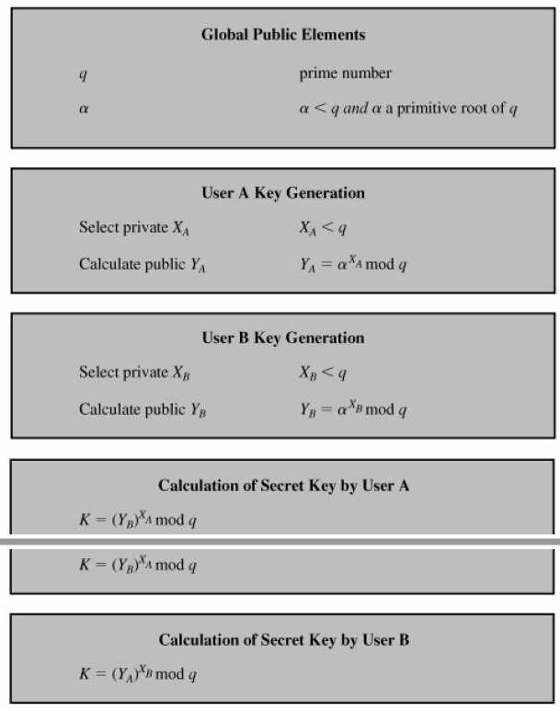
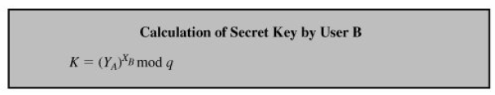
Diffie-Hellman Key Exchange
31

Slide 32
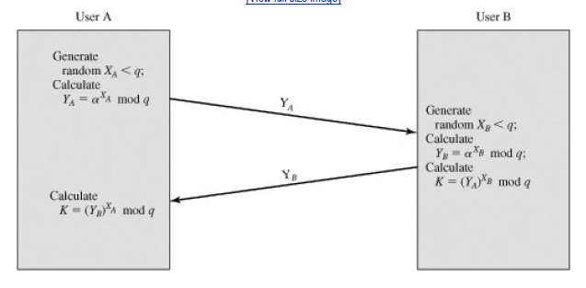
Diffie-Hellman Key Exchange
32

Slide 33
Key exchange is based on the use of the prime number q = 353 and a primitive root of 353, in this case a = 3. A and B select secret keys XA = 97 and XB = 233, respectively. Each computes its public key:
A computes YA = 3⁹⁷ mod 353 = 40.
B computes YB = 3²³³ mod 353 = 248.
After they exchange public keys, each can compute the common secret key:
A computes K = (YB)^{XA} mod 353 = 248⁹⁷ mod 353 =160.
B computes K = (YA)^{XB} mod 353 = 40²³³ mod 353 = 160.
33

Slide 34
Authentication Requirements
Attacks identified are
Disclosure: Release of message contents to any person or process not possessing the appropriate cryptographic key.
Traffic analysis: Discovery of the pattern of traffic between parties. In a connection-oriented application, the frequency and duration of connections could be determined. In either a connection-oriented or connectionless environment, the number and length of messages between parties could be determined.
Masqurade Insertion of messages into the network from a fraudulent source.
Content modification: Changes to the contents of a message, including insertion, deletion, transposition, and modification.
Sequence modification : Any modification to a sequence of messages between parties, including insertion, deletion, and reordering.
Timing modification : Delay or replay of messages. In a connection-oriented application, an entire session or sequence of messages could be a replay of some previous valid session, or individual messages in the sequence could be delayed or replayed. In a connectionless application, an individual message (e.g., datagram) could be delayed or replayed.
Source repudiation : Denial of transmission of message by source.
Destination repudiation : Denial of receipt of message by destination.
34

Slide 35
Authentication Functions
Any message authentication or digital signature mechanism has two levels of functionality.
At the lower level, there must be some sort of function that produces an authenticator: a value to be used to authenticate a message.
This lower-level function is then used as a primitive in a higher-level authentication protocol that enables a receiver to verify the authenticity of a message.
35

Slide 36
Authentication Functions
Functions that may be used to produce an authenticator. These may be grouped into three classes
Message encryption: The ciphertext of the entire message serves as its authenticator
Message authentication code (MAC): A function of the message and a secret key that produces a fixed-length value that serves as the authenticator
Hash function: A function that maps a message of any length into a fixed-length hash value, which serves as the authenticator
36

Slide 37
Message encryption: The ciphertext of the entire message serves as its authenticator
Message authentication code (MAC): A function of the message and a secret key that produces a fixed-length value that serves as the authenticator
Hash function: A function that maps a message of any length into a fixed-length hash value, which serves as the authenticator
37

Slide 38
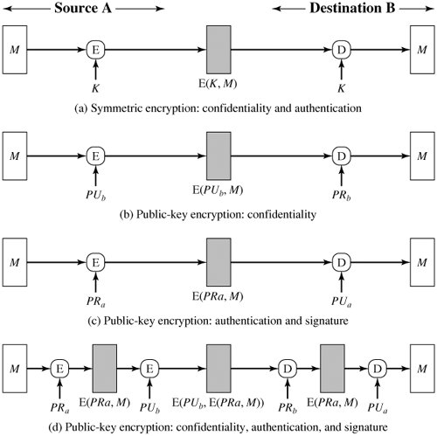
Message Encryption
Message encryption by itself can provide a measure of authentication. The analysis differs for symmetric and public-key encryption schemes.
38

Slide 39
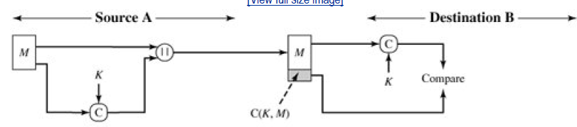
Authentication Functions: MAC
Message authentication
39

Slide 40
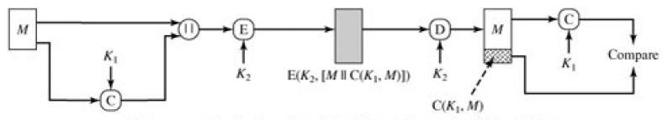
Authentication Functions: MAC
Message authentication and confidentiality: authentication tied to plaintext
40

Slide 41
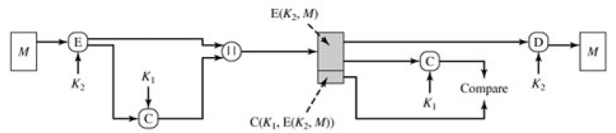
Authentication Functions: MAC
Message authentication and confidentiality: authentication tied to ciphertext
41

Slide 42


Authentication Functions: Hash Functions
Variety of ways in which a hash code can be used to provide message authentication
The message plus concatenated hash code is encrypted using symmetric encryption.
Only the hash code is encrypted, using symmetric encryption
42

Slide 43


Authentication Functions: Hash Functions
Only the hash code is encrypted, using public-key encryption and using the sender's private key.
If confidentiality as well as a digital signature is desired, then the message plus the private-key encrypted hash code can be encrypted using a symmetric secret key.
43

Slide 44


Authentication Functions: Hash Functions
It is possible to use a hash function but no encryption for message authentication.
Confidentiality can be added to the approach of (5) by encrypting the entire message plus the hash code.
44

Slide 45
Message Authentication Codes
A MAC, also known as a cryptographic checksum, is generated by a function C of the form
MAC = C(K, M)
where
M is a variable-length message,
K is a secret key shared only by sender and receiver, and
C(K,M) is the fixed-length authenticator.
The MAC is appended to the message at the source at a time when the message is assumed or known to be correct. The receiver authenticates that message by recomputing the MAC.
45

Slide 46
Requirements of MACs
MAC function should satisfy the following requirements:
If an opponent observes M and C(K, M), it should be computationally infeasible for the opponent to construct a message M' such that C(K, M') = C(K, M).
C(K, M) should be uniformly distributed in the sense that for randomly chosen messages, M and M', the probability that C(K, M) = C(K, M') is 2^{n}, where n is the number of bits in the MAC.
Let M' be equal to some known transformation on M. That is, M' = f(M). For example, f may involve inverting one or more specific bits. In that case, Pr[C(K, M) = C(K, M')] = 2^{n}.
46

Slide 47
Hash Functions
A hash value h is generated by a function H of the form
h = H(M)
where
M is a variable-length message and
H(M) is the fixed-length hash value.
The hash value is appended to the message at the source at a time when the message is assumed or known to be correct.
The receiver authenticates that message by recomputing the hash value. Because the hash function itself is not considered to be secret, some means is required to protect the hash value
47

Slide 48
Security of Hash Functions and Macs
As with symmetric and public-key encryption, we can group attacks on hash functions and MACs into two categories:
Brute-force attacks and
Cryptanalysis
48

Slide 49
Security of Hash Functions and Macs
Brute-Force Attacks
Hash Functions
The strength of a hash function against brute-force attacks depends solely on the length of the hash code produced by the algorithm.
Message Authentication Codes
A brute-force attack on a MAC is a more difficult undertaking because it requires known message-MAC pairs.
Cryptanalysis
The way to measure the resistance of a hash or MAC algorithm to cryptanalysis is to compare its strength to the effort required for a brute-force attack.
That is, an ideal hash or MAC algorithm will require a cryptanalytic effort greater than or equal to the brute-force effort.
49

Slide 50
Digital Signatures
Message authentication protects two parties who exchange messages from any third party.
However, it does not protect the two parties against each other. Several forms of dispute between the two are possible.
Suppose that John sends an authenticated message to Mary,
Consider the following disputes that could arise:
Mary may forge a different message and claim that it came from John. Mary would simply have to create a message and append an authentication code using the key that John and Mary share.
John can deny sending the message. Because it is possible for Mary to forge a message, there is no way to prove that John did in fact send the message.
In situations where there is not complete trust between sender and receiver, something more than authentication is needed.
50

Slide 51
Digital Signatures
Solution to this problem is the digital signature
It has the following properties:
It must verify the author and the date and time of the signature.
It must to authenticate the contents at the time of the signature.
It must be verifiable by third parties, to resolve disputes.
Thus, the digital signature function includes the authentication function
51

Slide 52
Requirements of digital signature
The signature must be a bit pattern that depends on the message being signed.
The signature must use some information unique to the sender, to prevent both forgery and denial.
It must be relatively easy to produce the digital signature.
It must be relatively easy to recognize and verify the digital signature.
It must be computationally infeasible to forge a digital signature, either by constructing a new message for an existing digital signature or by constructing a fraudulent digital signature for a given message.
It must be practical to retain a copy of the digital signature in storage.
52

Slide 53
Direct Digital Signatures
involve only sender & receiver
assumed receiver has sender’s public-key
digital signature made by sender signing entire message or hash with private-key
can encrypt using receivers public-key
important that sign first then encrypt message & signature
security depends on sender’s private-key
Notes:
53
The term direct digital signature refers to a digital signature scheme that involves only the communicating parties (source, destination). It is assumed that the destination knows the public key of the source. Direct Digital Signatures involve the direct application of public-key algorithms involving only the communicating parties. A digital signature may be formed by encrypting the entire message with the sender’s private key, or by encrypting a hash code of the message with the sender’s private key. Confidentiality can be provided by further encrypting the entire message plus signature using either public or private key schemes. It is important to perform the signature function first and then an outer confidentiality function, since in case of dispute, some third party must view the message and its signature. But these approaches are dependent on the security of the sender’s private-key. Will have problems if it is lost/stolen and signatures forged. The universally accepted technique for dealing with these threats is the use of a digital certificate and certificate authorities. We defer a discussion of this topic until Chapter 14, and focus in this chapter on digital signature algorithms. Also need time-stamps and timely key revocation.

Slide 54
Arbitrated Digital Signatures
involves use of an arbiter who
validates any signed message
then dated and sent to recipient
requires suitable level of trust in arbiter
can be implemented with either private or public-key algorithms
arbiter may or may not see message
Notes:
54
The problems associated with direct digital signatures can be addressed by using an arbiter, in a variety of possible arrangements, as shown in Stallings Table 13.1.
The arbiter plays a sensitive and crucial role in this sort of scheme, and all parties must have a great deal of trust that the arbitration mechanism is working properly.
These schemes can be implemented with either private or public-key algorithms, and the arbiter may or may not see the actual message contents.

Slide 55
Authentication Protocols
used to convince parties of each others identity and to exchange session keys
may be one-way or mutual
key issues are
confidentiality – to protect session keys
timeliness – to prevent replay attacks
published protocols are often found to have flaws and need to be modified
Notes:
55
Authentication Protocols are used to convince parties of each others identity and to exchange session keys. They may be one-way or mutual.
Central to the problem of authenticated key exchange are two issues: confidentiality and timeliness. To prevent masquerade and to prevent compromise of session keys, essential identification and session key information must be communicated in encrypted form. This requires the prior existence of secret or public keys that can be used for this purpose. The second issue, timeliness, is important because of the threat of message replays.
Stallings discusses a number of protocols that appeared secure but were revised after additional analysis. These examples highlight the difficulty of getting things right in the area of authentication.

Slide 56
Using Symmetric Encryption
Can use a two-level hierarchy of keys
usually with a trusted Key Distribution Center (KDC)
each party shares own master key with KDC
KDC generates session keys used for connections between parties
master keys used to distribute these to them
Notes:
56
A two-level hierarchy of symmetric encryption keys can be used to provide confidentiality for communication in a distributed environment.
Usually involves the use of a trusted key distribution center (KDC). Each party in the network shares a secret master key with the KDC. The KDC is responsible for generating session keys, and for distributing those keys to the parties involved, using the master keys to protect these session keys.

Slide 57
Needham-Schroeder Protocol
Used by 2 parties who both trust a common key server
original third-party key distribution protocol
for session between A B mediated by KDC
protocol overview is:
1. A->KDC: ID_{A} || ID_{B} || N₁
2. KDC -> A: E_{Ka}[Ks || ID_{B} || N₁ || E_{Kb}[Ks||ID_{A}] ]
3. A -> B: E_{Kb}[Ks||ID_{A}]
4. B -> A: E_{Ks}[N₂]
5. A -> B: E_{Ks}[f(N₂)]
f(N2) is a function making some changes on N2 so that owner of N2 can verify the correct receipt of N2, e.g., F(23456)= 23456+1. That 1 is the verifier code.
Notes:
57
The Needham-Schroeder Protocol is the original, basic key exchange protocol. Used by 2 parties who both trusted a common key server, it gives one party the info needed to establish a session key with the other. Note that since the key server chooses the session key, it is capable of reading/forging any messages between A&B, which is why they need to trust it absolutely!
Note that all communications is between A&KDC and A&B, B&KDC don't talk directly (though indirectly a message passes from KDC via A to B, encrypted in B's key so that A is unable to read or alter it). Other variations of key distribution protocols can involve direct communications between B&KDC.

Slide 58
Needham-Schroeder Protocol
used to securely distribute a new session key for communications between A & B
but is vulnerable to a replay attack if an old session key has been compromised
then message 3 can be resent convincing B that is communicating with A
modifications to address this require:
timestamps
using an extra nonce
Notes:
58
There is a critical flaw in the protocol, as shown. It can be corrected by either using timestamps, or an additional nonce, with respective advantages and limitations.
This example emphasises the need to be extremely careful in codifying assumptions, and tracking the timeliness of the flow of info in protocols. Designing secure protocols is not easy, and should not be done lightly. Great care and analysis is needed.

Slide 59
Using Public-Key Encryption
have a range of approaches based on the use of public-key encryption
need to ensure have correct public keys for other parties
using a central Authentication Server (AS)
various protocols exist using timestamps or nonces
Notes:
59
Have a range of approaches based on the use of public-key encryption, which generally assume that each of the two parties is in possession of the current public key of the other. The central system is known as an Authentication Server (AS). Have various protocols using timestamps or nonces, and again flaws were found in a number of the original proposals. See text for details.

Slide 60
Denning Authentication Server Protocol
Denning presented the following:
1. A -> AS: ID_{A} || ID_{B}
2. AS -> A: E_{PRas}[ID_{A}||PU_{a}||T] || E_{PRas}[ID_{B}||PU_{b}||T]
3. A -> B: E_{PRas}[ID_{A}||PU_{a}||T] || E_{PRas}[ID_{B}||PU_{b}||T] || E_{PUb}[E_{PRa}[K_{s}||T]]
Note that to avoid the risk of exposure by the AS session key is chosen by A, hence AS need not be trusted to protect it
timestamps prevent replay attacks but require synchronized clocks
Notes:
60
A protocol using timestamps is provided in [DENN81] is shown above.
The central authentication server (AS) only provides public-key certificates.
The session key is chosen and encrypted by A; hence, there is no risk of exposure by the AS.
The timestamps protect against replays of compromised keys. This protocol is compact but, as before, requires synchronization of clocks.

Slide 61
One-Way Authentication
The recipient wants some assurance that the message is from the alleged sender. One-Way Authentication addresses these requirements.
Required when sender & receiver communicate in connectionless mode (eg. email)
Have header in clear text so can be delivered by email systems
May want contents of body protected & sender authenticated
Notes:
61
One application for which encryption is growing in popularity is electronic mail (e-mail). The very nature of electronic mail, and its chief benefit, is that it is not necessary for the sender and receiver to be online at the same time. Instead, the e-mail message is forwarded to the receiver’s electronic mailbox,where it is buffered until the receiver is available to read it. The “envelope” or header of the e-mail message must be in the clear so that the message can be handled by the store-and-forward e-mail protocol. However it is often desirable that e-mail message be encrypted such that the mail-handling system is not in possession of the decryption key. A second requirement is that of authentication, where the recipient wants some assurance that the message is from the alleged sender. One-Way Authentication addresses these requirements.

Slide 62
One-Way Authentication Using Symmetric Encryption
can refine use of KDC but can’t have final exchange of nonces:
1. A->KDC: ID_{A} || ID_{B} || N₁
2. KDC -> A: E_{Ka}[Ks || ID_{B} || N₁ || E_{Kb}[Ks||ID_{A}] ]
3. A -> B: E_{Kb}[Ks||ID_{A}] || E_{Ks}[M]
does not protect against replays
could rely on timestamp in message, though email delays make this problematic
Notes:
62
Using symmetric encryption, with some refinement, the KDC strategy is a candidate for encrypted electronic mail. Because we wish to avoid requiring that the recipient be on line at the same time as the sender, steps 4 and 5 must be eliminated, leaving the protocol as shown.
This approach guarantees that only the intended recipient of a message will be able to read I, and also provides a level of authentication that the sender is A. As specified, the protocol does not protect against replays. You could rely on timestamp in the message, though email delays make this problematic.

Slide 63
One-Way Authentication Using Public-Key Approaches
have seen some public-key approaches
if confidentiality is major concern, can use:
A->B: E_{PUb}[Ks] || E_{Ks}[M]
has encrypted session key, encrypted message
if authentication needed use a digital signature with a digital certificate:
A->B: M || E_{PRa}[H(M)] || E_{PRa}[T||ID_{A}||PU_{a}]
with message, signature, certificate
Notes:
63
Have already presented public-key encryption approaches that are suited to electronic mail, including the straight forward encryption of the entire message for confidentiality, authentication, or both. These approaches require that either the sender know the recipient’s public key (confidentiality) or the recipient know the sender’s public key (authentication) or both (confidentiality plus authentication). In addition, the public-key algorithm must be applied once or twice to what may be a long message.
If confidentiality is the primary concern, then the message can be encrypted with a one-time secret key, which in in turn is encrypted with B’s public key.
To achieve authentication, and to validate the senders public key, the signature can be encrypted with the recipient’s public key, and for assurance A’s public key is sent in a digital certificate, as shown. To obtain confidentiality as well, the message can be encrypted with a session key, combining both options above.

Slide 64
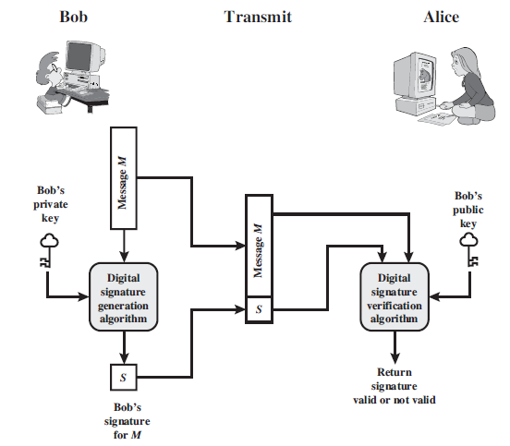
Digital Signature Process
64

Slide 65
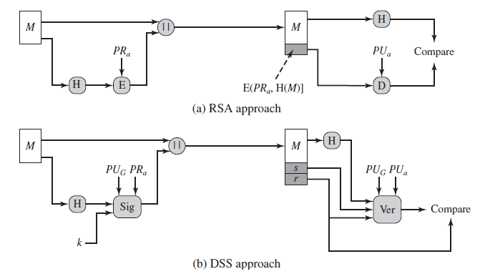
Two approaches to Digital Signatures
65

Slide 66
Digital Signature Standard (DSS)
US Govt approved signature scheme
designed by NIST & NSA in early 90's
published as FIPS-186 in 1991
revised in 1993, 1996 & then 2000
uses the SHA hash algorithm
DSS is the standard, DSA is the algorithm
FIPS 186-2 (2000) includes alternative RSA & elliptic curve signature variants
DSA is digital signature only unlike RSA
is a public-key technique
Notes:
66
DSA is the US Govt approved signature scheme, which is designed to provide strong signatures without allowing easy use for encryption. The National Institute of Standards and Technology (NIST) published Federal Information Processing Standard FIPS 186, known as the Digital Signature Standard (DSS). The DSS makes use of the Secure Hash Algorithm (SHA) described in Chapter 12 and presents a new digital signature technique, the Digital Signature Algorithm (DSA). The DSS was originally proposed in 1991 and revised in 1993 in response to public feedback concerning the security of the scheme. There was a further minor revision in 1996. In 2000, an expanded version of the standard was issued as FIPS 186-2. This latest version also incorporates digital signature algorithms based on RSA and on elliptic curve cryptography. In this section, we discuss the original DSS algorithm. The DSS uses an algorithm that is designed to provide only the digital signature function. Unlike RSA, it cannot be used for encryption or key exchange. Nevertheless, it is a public-key technique.

Slide 67
Digital Signature Algorithm (DSA)
creates a 320 bit signature
with 512-1024 bit security
smaller and faster than RSA
a digital signature scheme only
security depends on difficulty of computing discrete logarithms
variant of ElGamal & Schnorr schemes
Notes:
67
The DSA is based on the difficulty of computing discrete logarithms (see Chapter 8) and is based on schemes originally presented by ElGamal [ELGA85] and Schnorr [SCHN91]. The DSA signature scheme has advantages, being both smaller (320 vs 1024bit) and faster (much of the computation is done modulo a 160 bit number), over RSA. Unlike RSA, it cannot be used for encryption or key exchange. Nevertheless, it is a public-key technique

Slide 68
DSA Key Generation
have shared global public key values (p,q,g):
choose 160-bit prime number q
choose a large prime p with 2^{L-1} < p < 2^{L}
where L= 512 to 1024 bits and is a multiple of 64
such that q is a 160 bit prime divisor of (p-1)
choose g = h^{(p-1)/q}
where 1<h<p-1 and h^{(p-1)/q} mod p > 1
users choose private & compute public key:
choose random private key: x<q
compute public key: y = g^{x} mod p
Notes:
68
DSA typically uses a common set of global parameters (p,q,g) for a community of clients, as shown. A 160-bit prime number q is chosen. Next, a prime number p is selected with a length between 512 and 1024 bits such that q divides (p – 1). Finally, g is chosen to be of the form h^{(p–1)/q} mod p where h is an integer between 1 and (p – 1) with the restriction that g must be greater than 1. Thus, the global public key components of DSA have the same for as in the Schnorr signature scheme.
Then each DSA uses chooses a random private key x, and computes their public key as shown. The calculation of the public key y given x is relatively straightforward. However, given the public key y, it is computationally infeasible to determine x, which is the discrete logarithm of y to base g, mod p.

Slide 69
DSA Signature Creation
to sign a message M the sender:
generates a random signature key k, k<q
nb. k must be random, be destroyed after use, and never be reused
then computes signature pair:
r = (g^{k} mod p)mod q
s = [k⁻¹(H(M)+ xr)] mod q
sends signature (r,s) with message M
Notes:
69
To create a signature, a user calculates two quantities, r and s, that are functions of the public key components (p,q,g), the user’s private key (x), the hash code of the message H(M), and an additional integer k that should be generated randomly or pseudo-randomly and be unique for each signing. This is similar to ElGamal signatures, with the use of a per message temporary signature key k, but doing calculations first mod p, then mod q to reduce the size of the result. The signature (r,s) is then sent with the message to the recipient. Note that computing r only involves calculation mod p and does not depend on message, hence can be done in advance. Similarly with randomly choosing k’s and computing their inverses.

Slide 70
DSA Signature Verification
having received M & signature (r,s)
to verify a signature, recipient computes:
w = s⁻¹ mod q
u1= [H(M)w ]mod q
u2= (rw)mod q
v = [(g^{u1} y^{u2})mod p ]mod q
if v=r then signature is verified
see Appendix A for details of proof why
Notes:
70
At the receiving end, verification is performed using the formulas shown. The receiver generates a quantity v that is a function of the public key components, the sender’s public key, and the hash of the incoming message. If this quantity matches the r component of the signature, then the signature is validated. Note that the difficulty of computing discrete logs is why it is infeasible for an opponent to recover k from r, or x from s. Note also that nearly all the calculations are mod q, and hence are much faster save for the last step.
The structure of this function is such that the receiver can recover r using the incoming message and signature, the public key of the user, and the global public key. It is certainly not obvious that such a scheme would work. A proof is provided in Stallings appendix K.

Slide 71
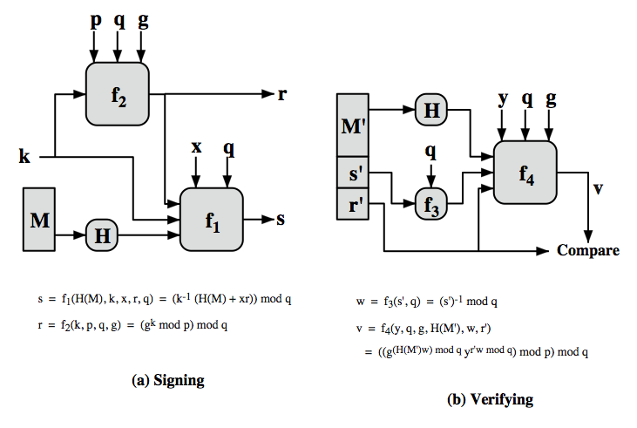
DSS Overview
Notes:
Stallings Figure 13.5 depicts the functions of signing and verifying. The structure of the algorithm, as revealed here is quite interesting. Note that the test at the end is on the value r, which does not depend on the message at all. Instead, r is a function of k and the three global public-key components. The multiplicative inverse of k (mod q) is passed to a function that also has as inputs the message hash code and the user's private key. The structure of this function is such that the receiver can recover r using the incoming message and signature, the public key of the user, and the global public key.
71

